Slide 1
Outline
Microstrip Line
Coplanar Waveguide (CPW)
General Solution for TE, TM, and TEM Waves
TEM Waves
TE Waves
TM Waves
Parallel Plate Waveguide
Rectangular Waveguide
Coaxial Line

Slide 2
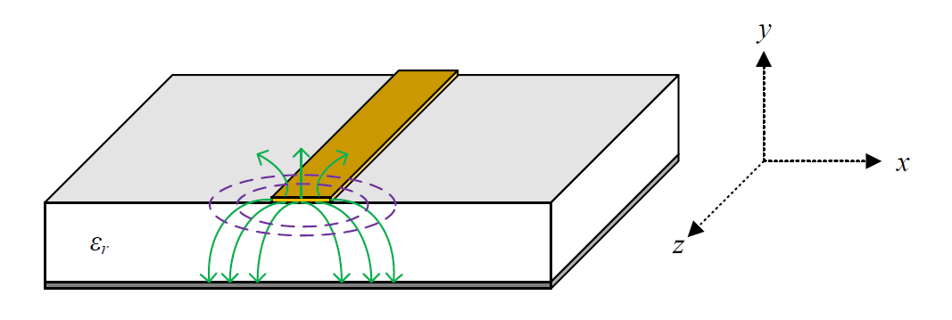
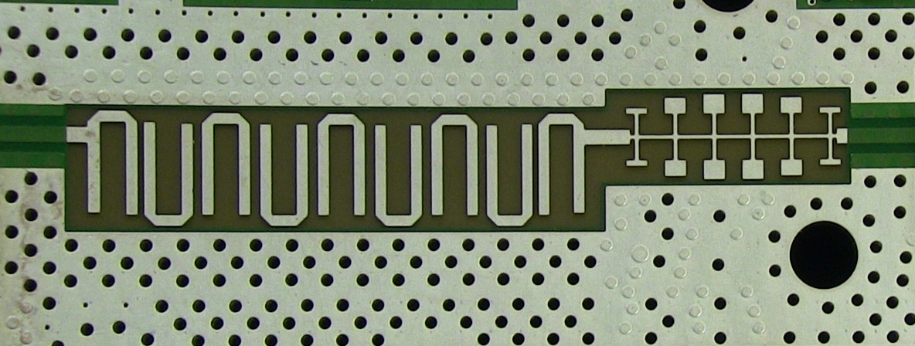
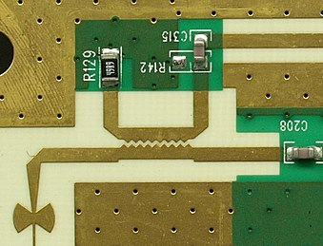
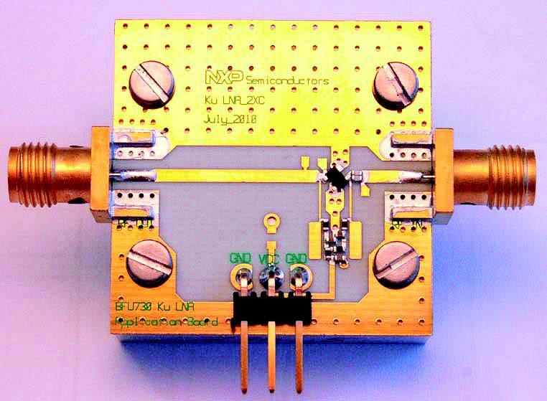
Microstrip Line
Hair pin bandpass filter
Low pass filter
Directional Coupler
Low Noise Amplifier

Slide 3
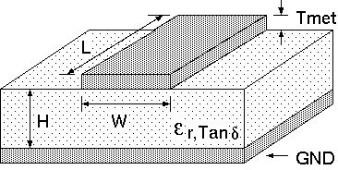
Microstrip Line
Wide Lines → Large C/Unit Length → Low impedance
Narrow Lines → Small C/Unit Length→ High impedance
Wide Lines → fields mostly in dielectric → (ε_{eff} → ε_{r})
Narrow Lines → a lot of fields in air → (ε_{eff} → (ε_{r}+1)/2)
Wide Lines → Small Resistance → Low Loss
Narrow Lines → Large Resistance → High Loss

Slide 4
Microstrip Line
H < λ_{g}/15 before radiation occurs in the substrate → Typical H (λ_{g}/30 → λ_{g}/15)
Less H → less W for the same Z₀
Reduce circuit size but induce more loss
In RF applications, H ~ λ_{g}/100 to result in compact circuits
Analytic formulas for calculating ε_{eff} , Z₀ are in Pozar’s book
Use ADS LineCal/HFSS to calculate all the properties of Microstrip line

Slide 5
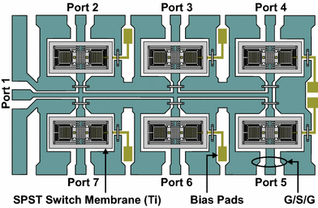
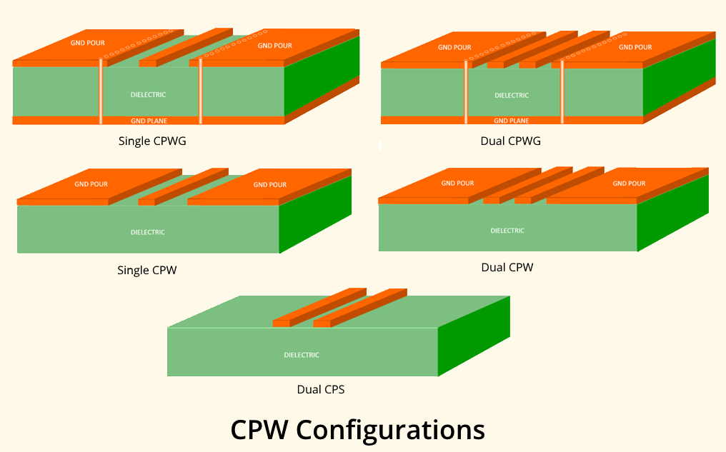
Coplanar Waveguide (CPW)
SP6T MEMS Switch
Cheng P. Wen is the inventor of Coplanar Waveguide in 1969, when working at RCA's Sarnoff Laboratories. The initial paper he published was: "Coplanar Waveguide: a surface strip transmission line suitable for nonreciprocal gyromagnetic device applications".

Slide 6
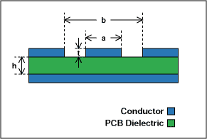
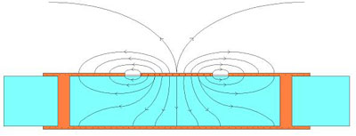
Coplanar Waveguide (CPW)
Larger a → Lower impedance
Larger b-a (larger gap) → Higher impedance
Larger h → Less dependence of Z₀ on h
Larger ε → Lower impedance

Slide 7
General Solutions for TE, TM, and TEM
Assume the wave is propagating in +z direction.
Assume the wave is propagating in source-free regions (no charge, no current)

Slide 8
General Solutions for TE, TM, and TEM

Slide 9
TEM Waves (E_{z} = H_{z} = 0)
Only if
TEM waves can exist
The transverse fields of a TEM wave are identical to the static fields that can exist between conductors.

Slide 10
TEM Waves
Therefore we can use the method in electric static fields
With boundary conditions, we can find the voltage at any location in the transverse plane.
The E field can be derived using:
The H field can be derived using:

Slide 11
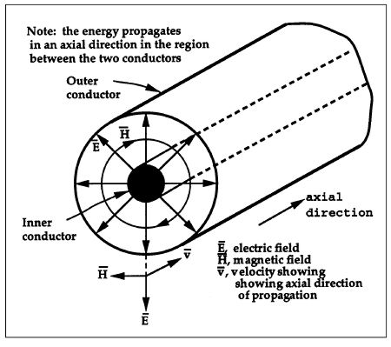
TEM Waves
In order to support TEM waves, at least two separate conductors are necessary.

Slide 12
TE Waves (E_{z} = 0)
To solve for all field components, H_{z} needs to be found first:
since

Slide 13
TM Waves (H_{z} = 0)
To solve for all field components, E_{z} needs to be found first:
since
Both TE and TM waves can be supported inside closed conductors.

Slide 14
Parallel Plate Waveguide - TEM
y
V =V₀
d
x
V =0
W
H Field can be found:
Solve for the voltage with the given B.C.
E Field can be found:
You have already simulated the vector fields using HFSS

Slide 15
Parallel Plate Waveguide - TEM
y
V =V₀
d
x
V =0
W

Slide 16
Parallel Plate Waveguide - TM
y
d
x
W
Cutoff frequency is determined by
B.C.

Slide 17
Parallel Plate Waveguide - TM
y
d
x
W
Bouncing plane wave interpretation:
k
k
e
e
z
h
h
y
Do your homework: plot the vector field distribution using HFSS

Slide 18
Parallel Plate Waveguide - TE
y
d
x
W
Cutoff frequency is determined by
B.C.

Slide 19
Parallel Plate Waveguide - TE
y
d
x
W
Bouncing plane wave interpretation:
k
k
h
h
z
e
e
y
Do your homework: plot the vector field distribution using HFSS

Slide 20
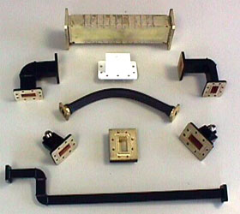
Rectangular Waveguide - TE
y
b
x
a
Separation of Variables

Slide 21
Rectangular Waveguide - TE
y
b
x
a
Boundary Conditions:
0
0
m, n cannot be 0 at the same time

Slide 22
Rectangular Waveguide - TE
y
b
x
a

Slide 23
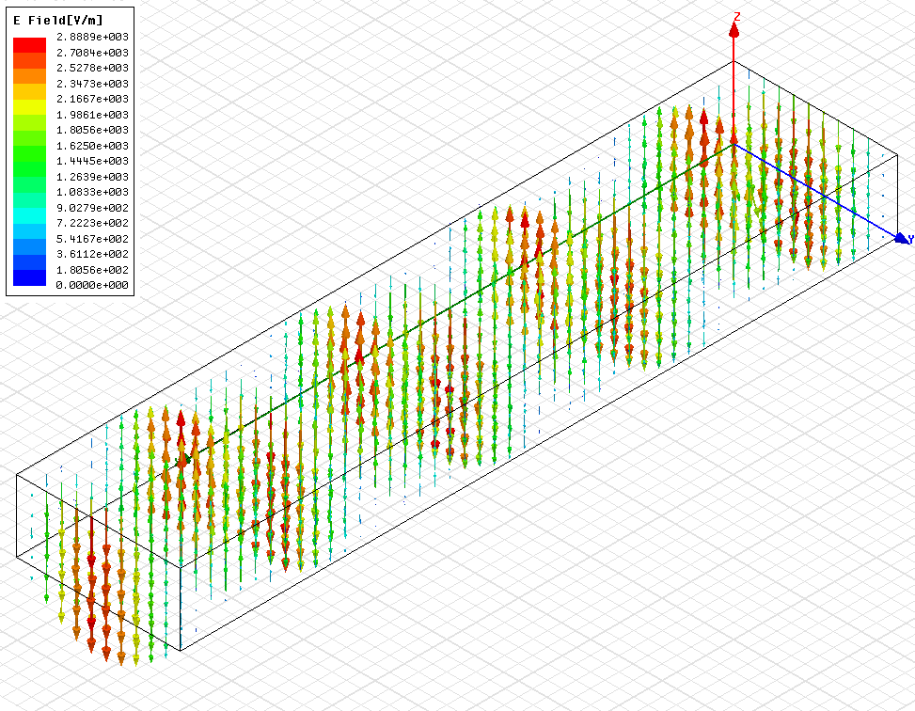
Rectangular Waveguide – TE₁₀

Slide 24
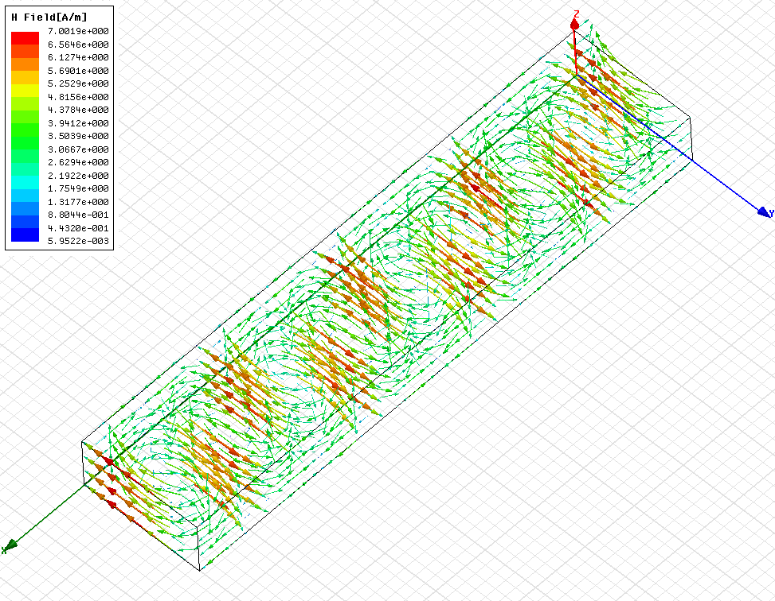
Rectangular Waveguide – TE₁₀

Slide 25
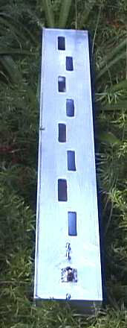
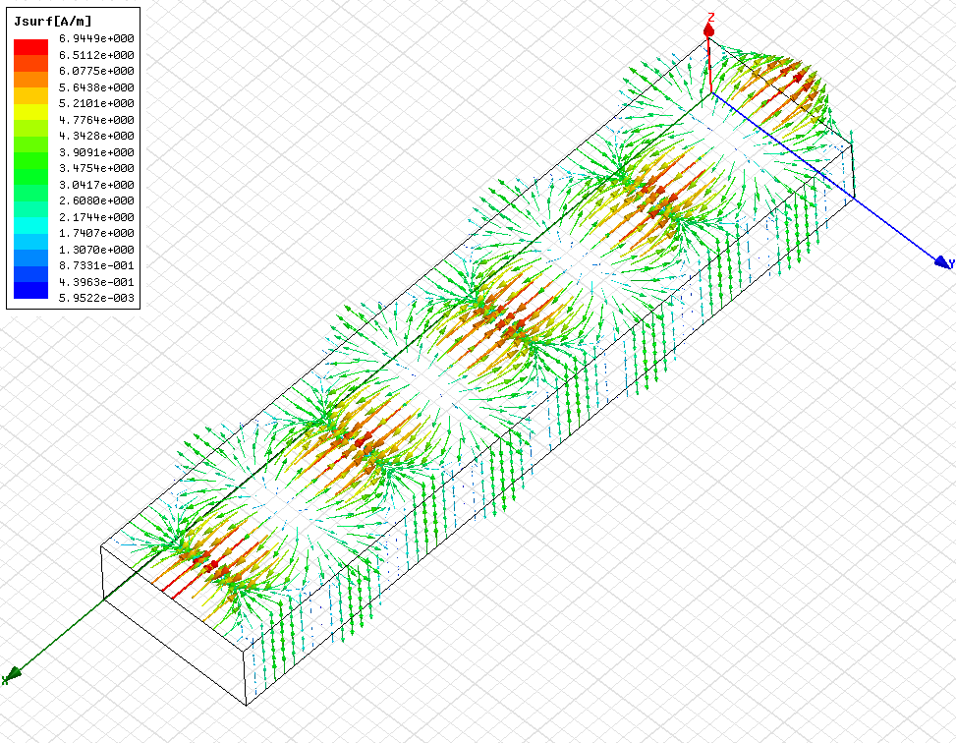
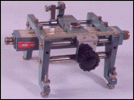
Rectangular Waveguide – TE₁₀
Waveguide slotted line
slotted Waveguide antenna
Surface Current

Slide 26
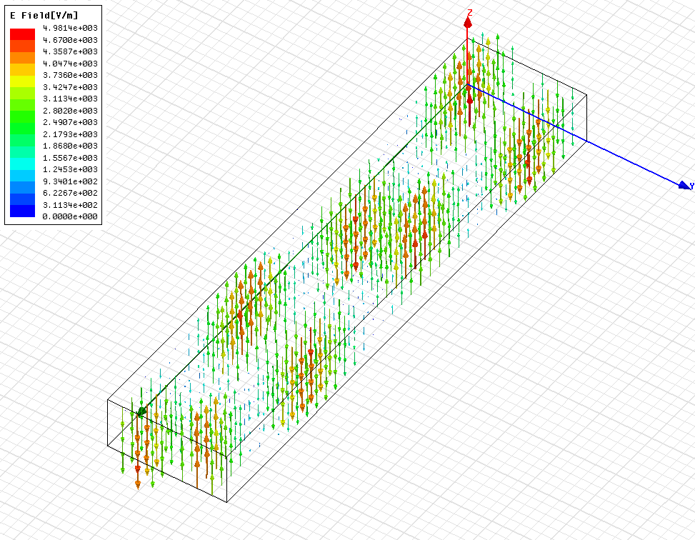
Rectangular Waveguide – TE₂₀

Slide 27
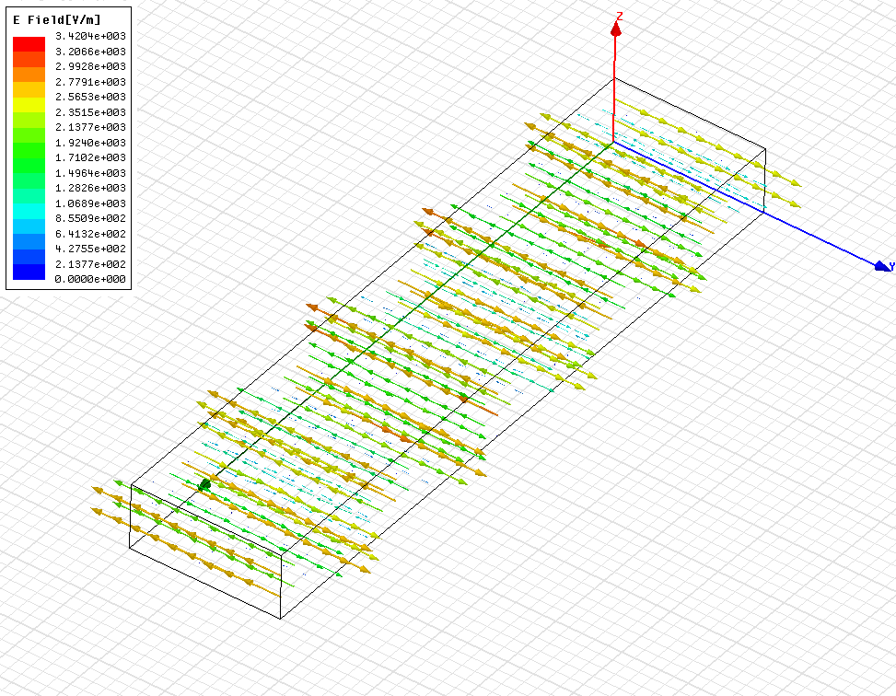
Rectangular Waveguide – TE₀₁

Slide 28
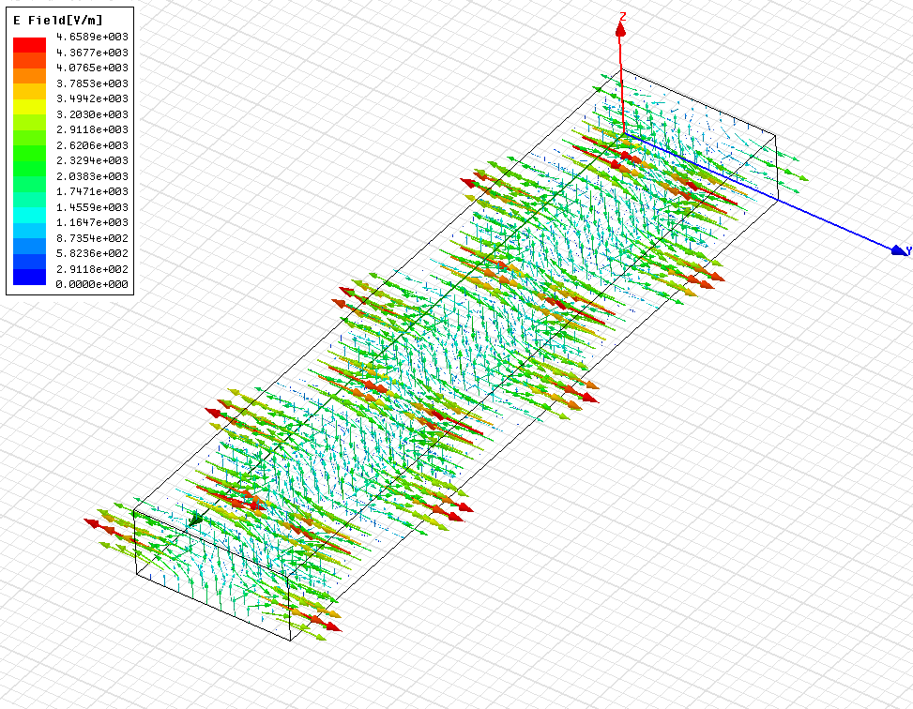
Rectangular Waveguide – TE₁₁

Slide 29
Rectangular Waveguide - TM
y
b
x
a
Separation of Variables

Slide 30
Rectangular Waveguide - TM
y
b
x
a
0
0
Boundary Conditions:
m, n cannot be 0

Slide 31
Rectangular Waveguide - TM
y
b
x
a

Slide 32
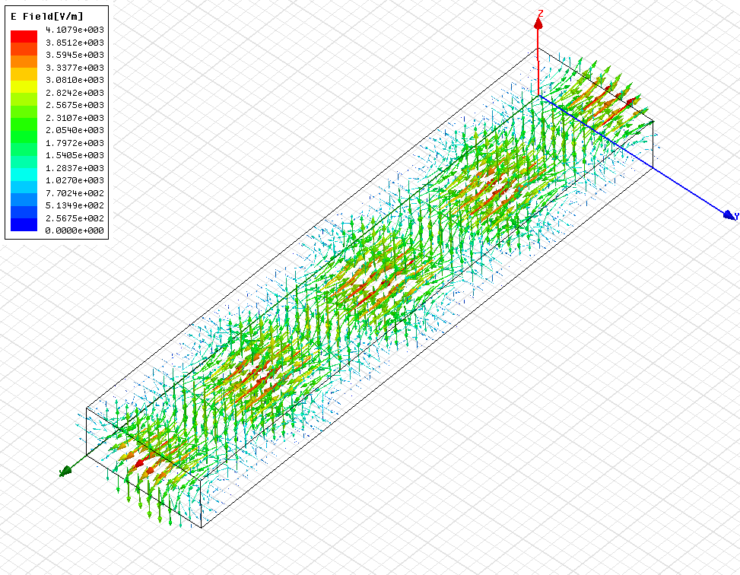
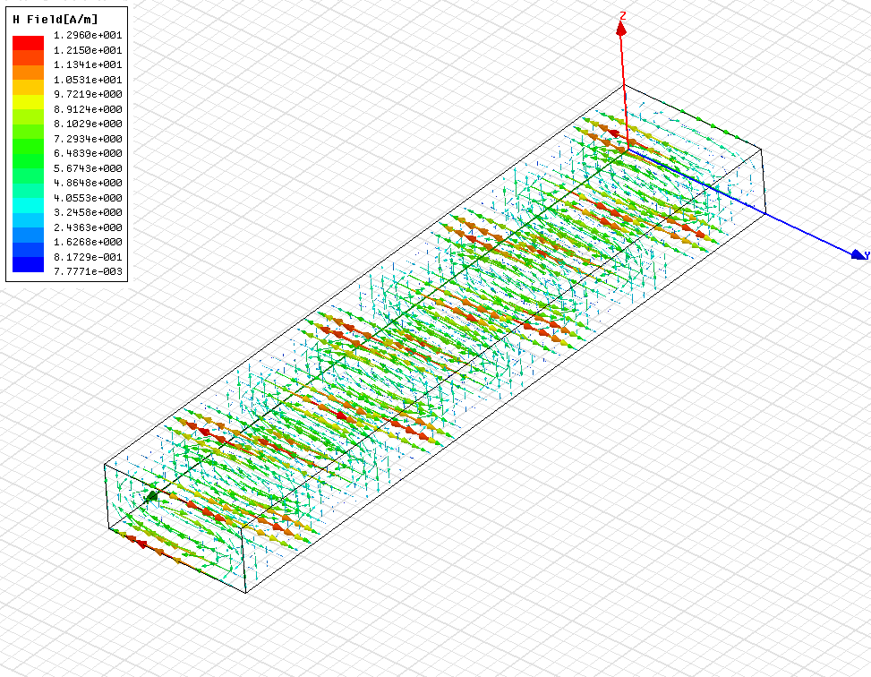
Rectangular Waveguide – TM₁₁

Slide 33
Rectangular Waveguide Modes
X band Waveguide: a= 22.86 mm , b= 10.16 mm
Mode | m | n | f_{c} (GHz)
TE | 1 | 0 | 6.56
TE | 2 | 0 | 13.12
TE | 0 | 1 | 14.76
TM,TE | 1 | 1 | 16.156
Working frequency is between 6.56 and 13.12 GHz for single mode Operation

Slide 34
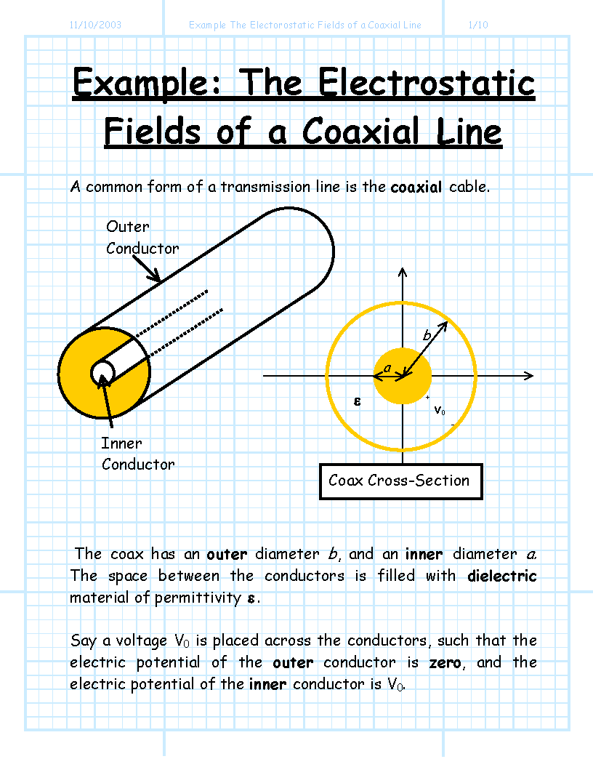
Coaxial Line

Slide 35
Coaxial Line - TEM
Laplace Equation for voltage:
Separation of Variables

Slide 36
Coaxial Line - TEM
Since the voltage is constant for different angles, n = 0
Therefore,
Since

Slide 37
Coaxial Line - TEM

Slide 38
Coaxial Line – Higher-Order Modes
Coaxial lines support TEM, TE, and TM modes
Usually coaxial lines operate in single mode condition TEM
It is important to know the cutoff frequencies of higher-order modes
TE₁₁ is the first higher-order mode
For TE modes, E_{z} = 0
B.C.

Slide 39
Coaxial Line – Higher-Order Modes
Transcendental
When n = 1

